Slide 1
z/OS DevOps DBB Samples zAppBuild A Generic Build Framework v1.0.6
Nelson Lopez
Z DevOps Transformation Specialist
Nelson.lopez1@ibm.com

Slide 2
Objectives
DBB’s Java API toolkit
Groovy and the toolkit
Generic Groovy Framework Sample - zAppBuild

Slide 3


DBB Architecture
DBB WebApp
- Dependency Metadata
Build Results History
z/OS
DBB Toolkit
Agent
MVS API’s
PDS
Groovy Build scripts
Compile
&
link
Scan, impact analysis, copy to PDS, compile, create artifacts, & report
USS
MVS

Slide 4
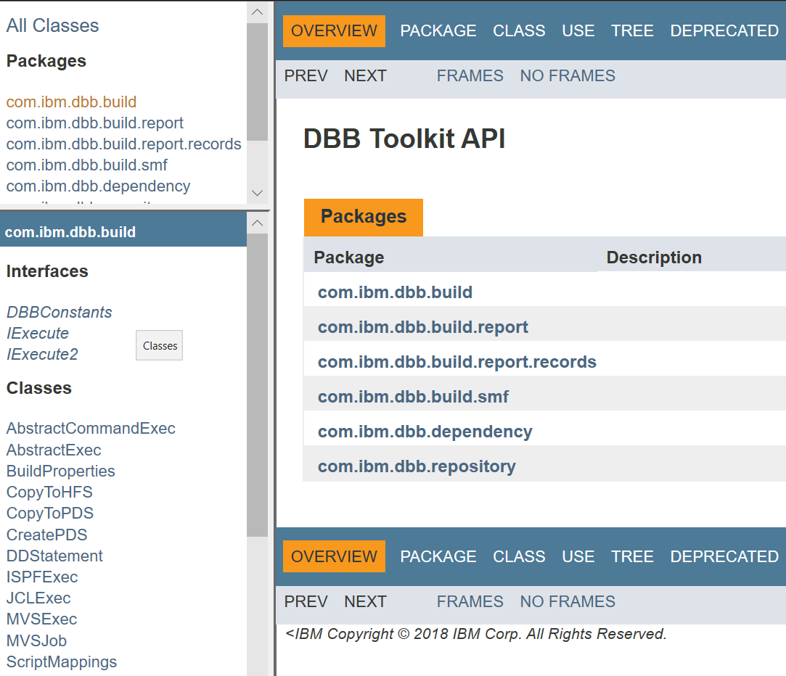
DBB Java API Toolkit
A set of Java APIs used to define scripts that:
Run MVS programs, TSO/ISPF commands, Submit JCL
Scan, store and retrieve application dependency metadata
Utilities to copy to/from PDS’s and USS zFS
Migrate source from PDS’s to Git

Slide 5
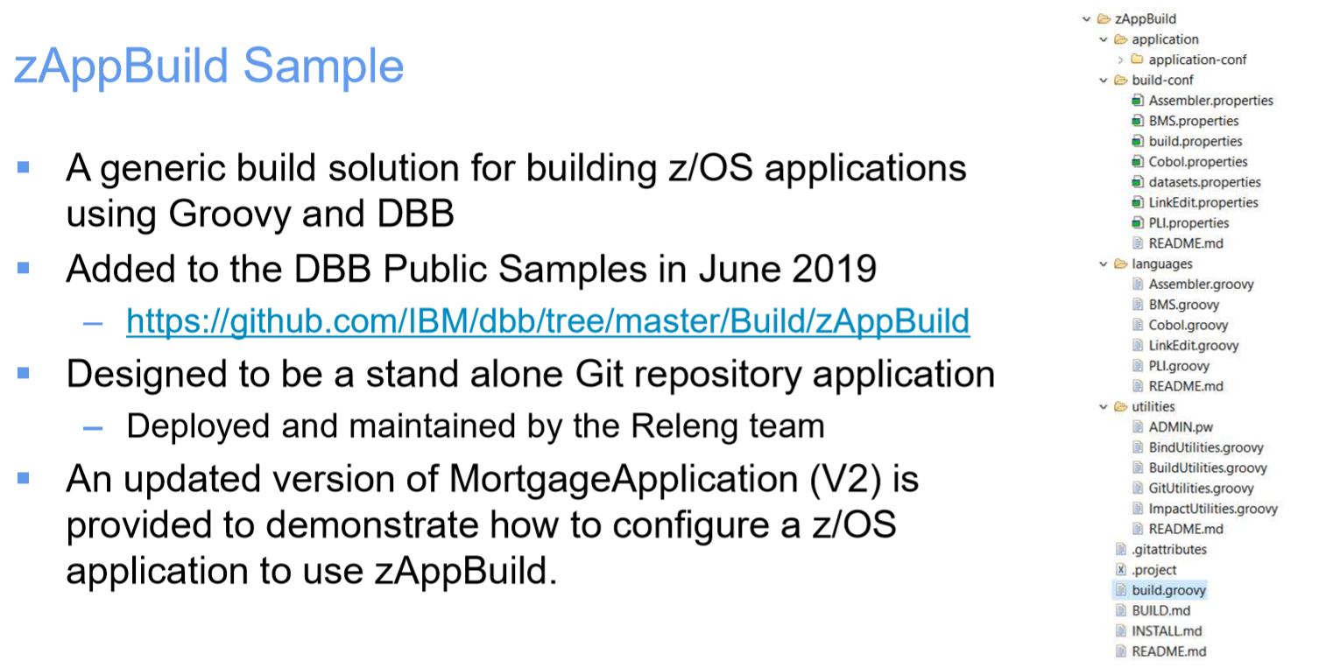

Slide 6
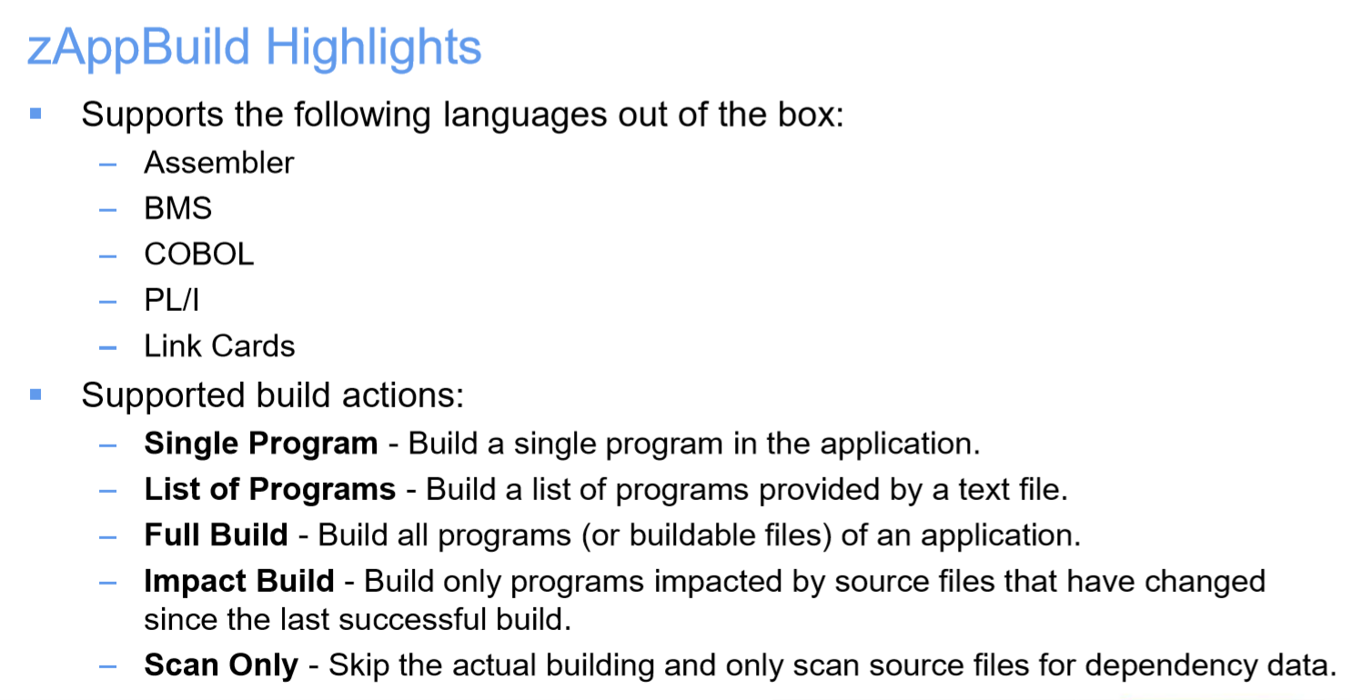

Slide 7
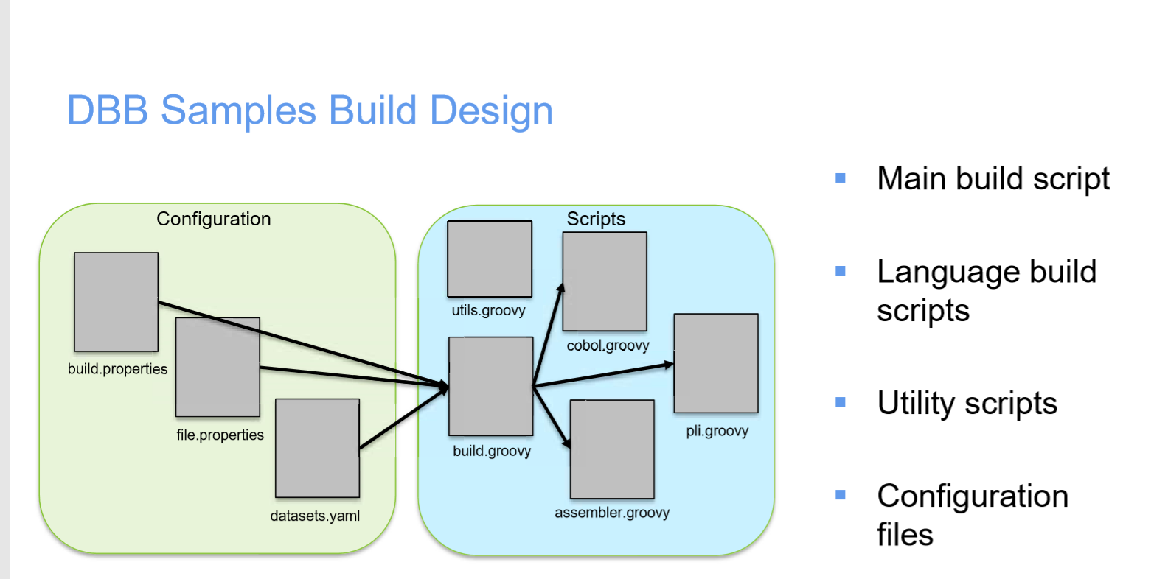

Slide 8
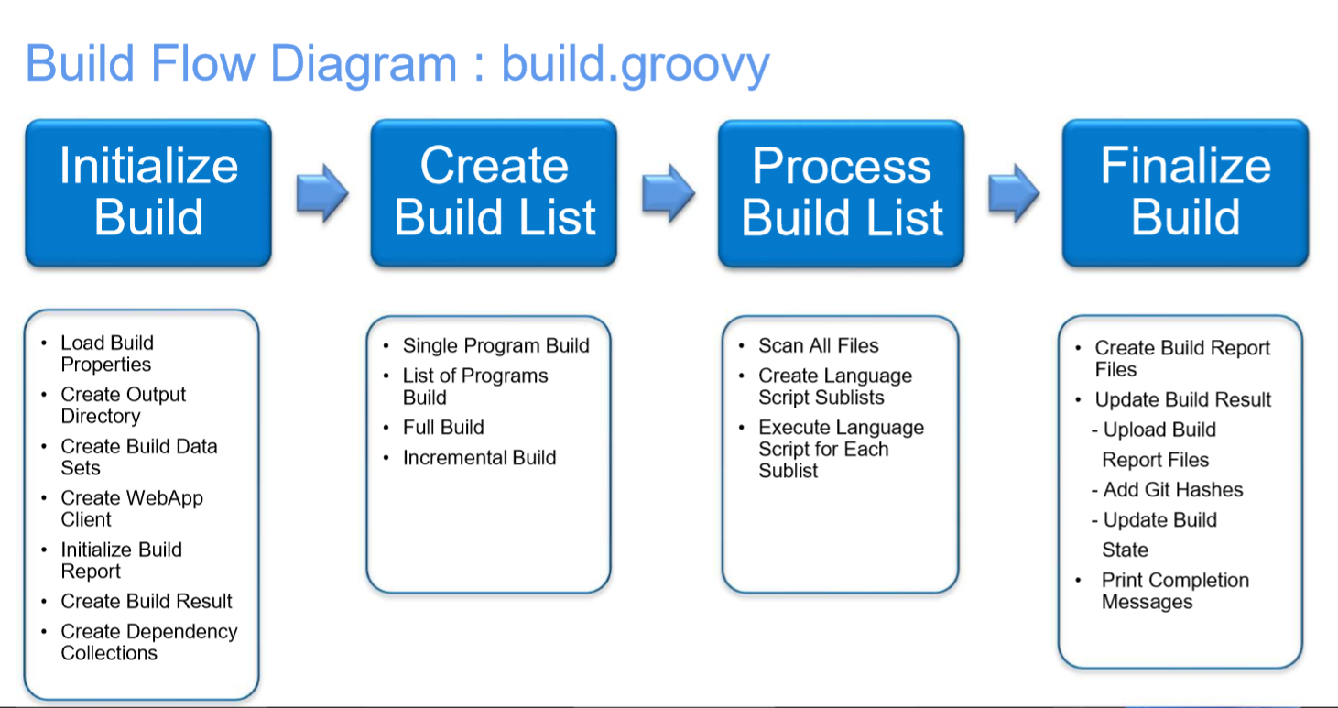
Impact build
Scan only

Slide 9
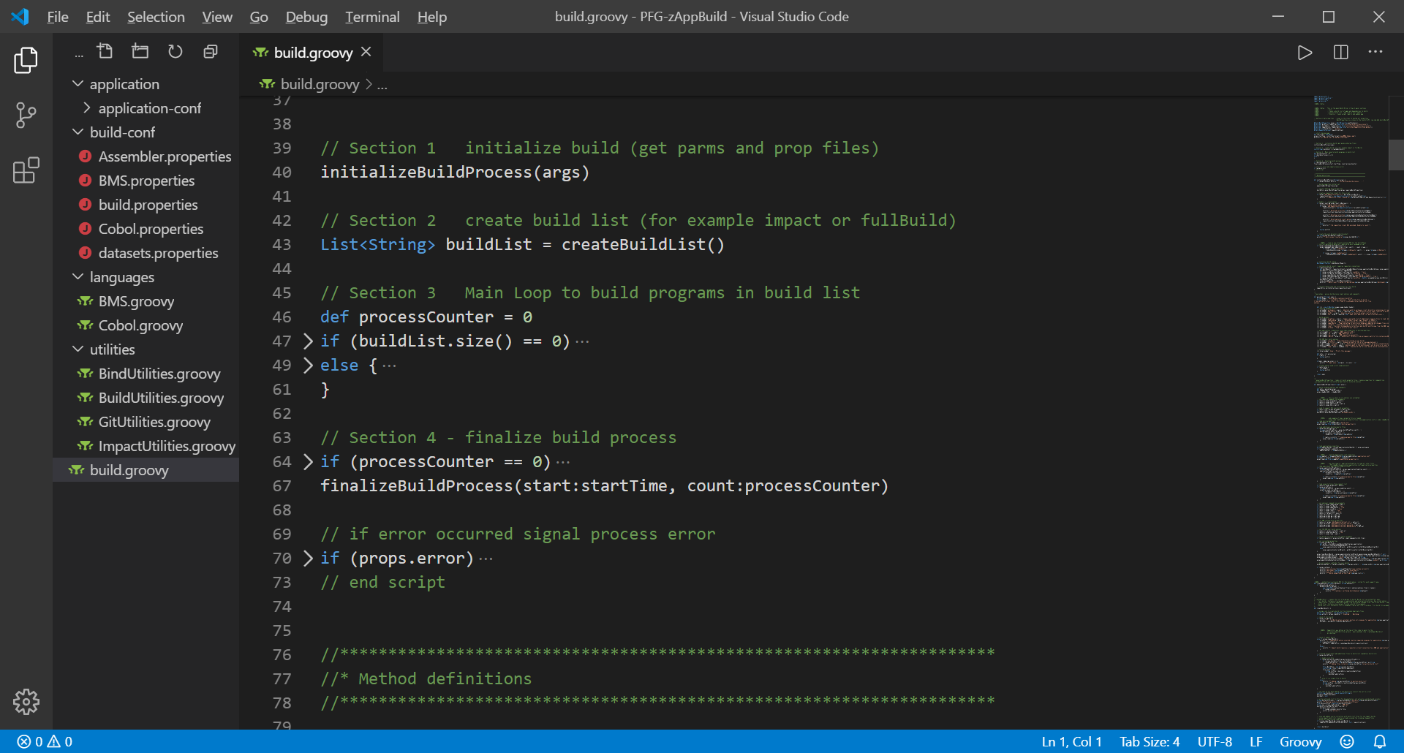
build.groovy
1- Initialize
2- Create
Build List
3 -LOOP
Build List
Finalize

Slide 10
